Slide 1
Pneumonia detection in chest X-ray images using deep learning models
Presenter : Yiang Yuet Meng

Slide 2
Agenda
Background
Exploratory Data Analysis
Feature Engineering
Evaluation Metrics
CNN Model
Modelling
Error Analysis
Summary

Slide 3
Background
There is an outbreak of bacteria in the community that is affecting children and elderly. The infection can be detected via Chest X ray.
The normal chest X-ray depicts clear lungs without any areas of abnormal opacification in the image.
Bacterial pneumonia typically exhibits a focal lobar consolidation
whereas viral pneumonia manifests with a more diffuse ‘‘interstitial’’ pattern in both lungs.
We are establishing a diagnostic tool based on a deep-learning framework for the screening of patients that are affected by this bacteria so that doctors can focus on the treatment

Slide 4
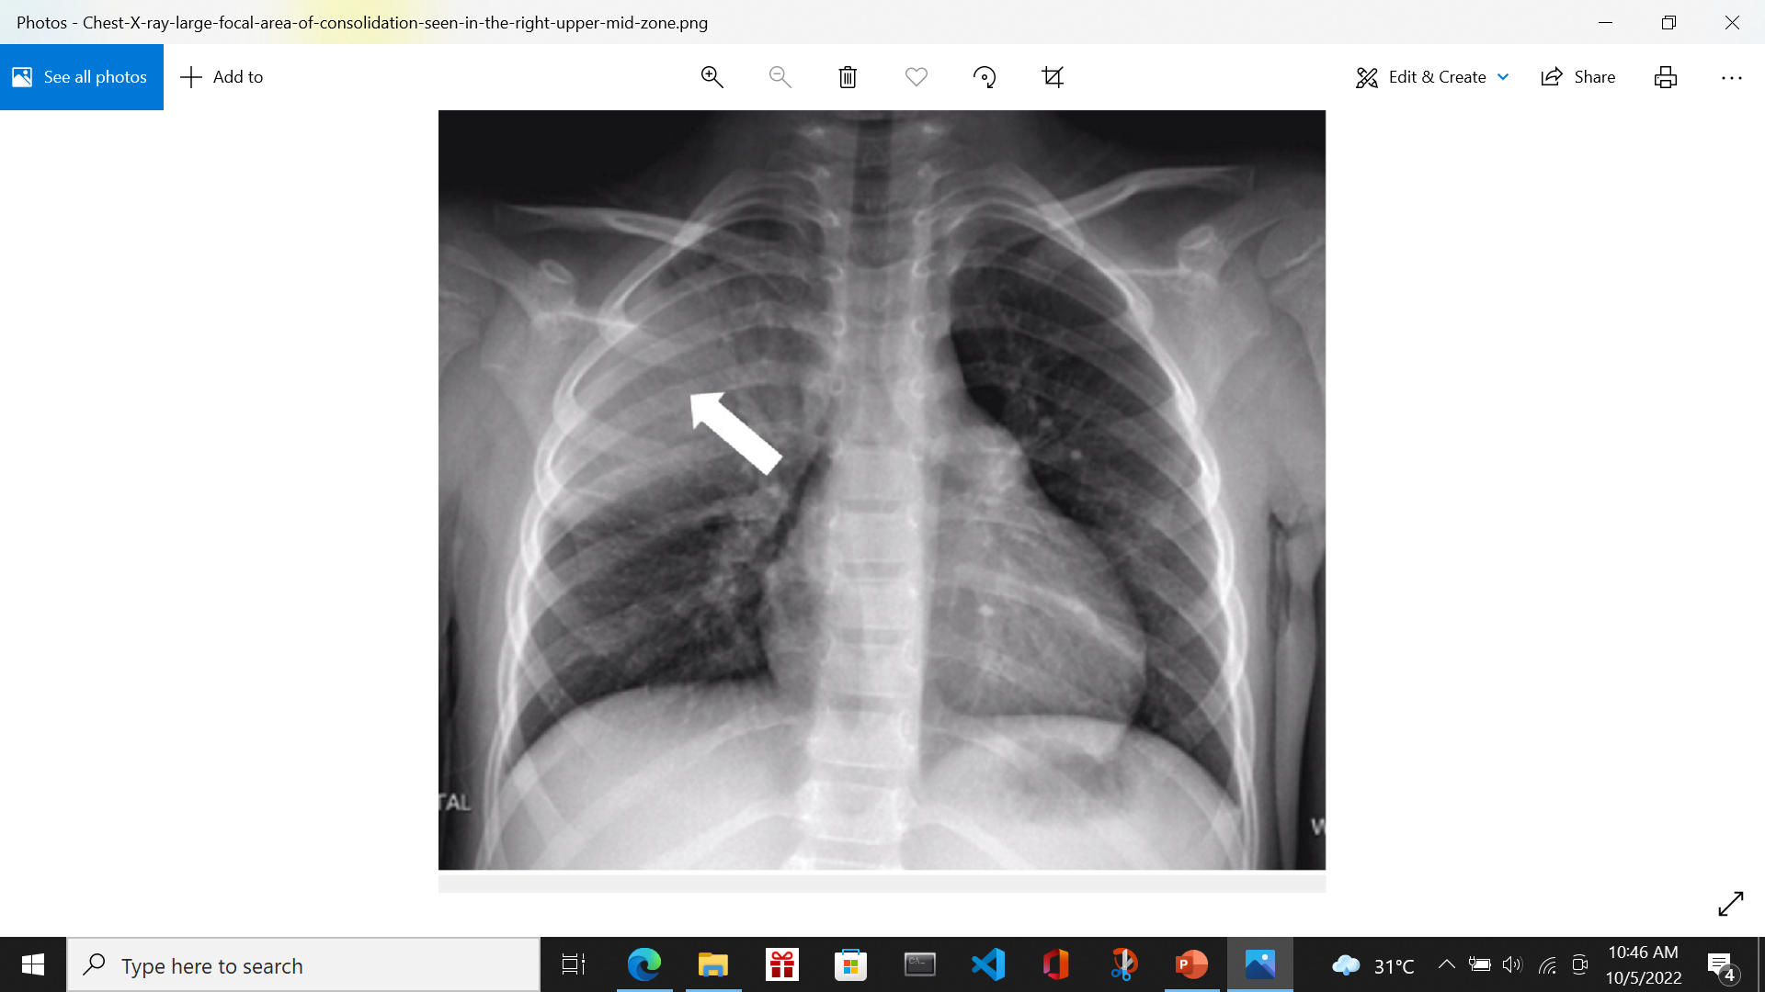
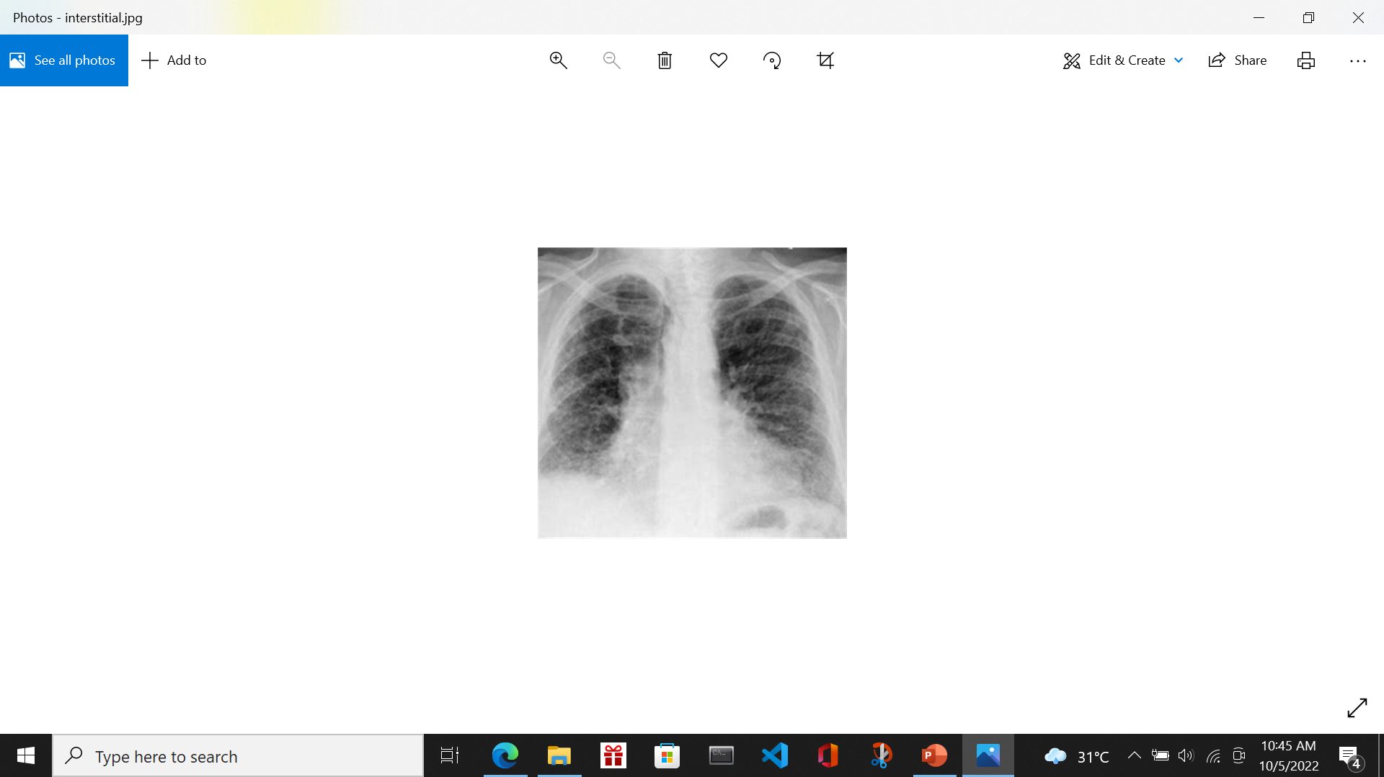
Background
focal lobar consolidation
diffuse ‘‘interstitial’’ in both lungs

Slide 5
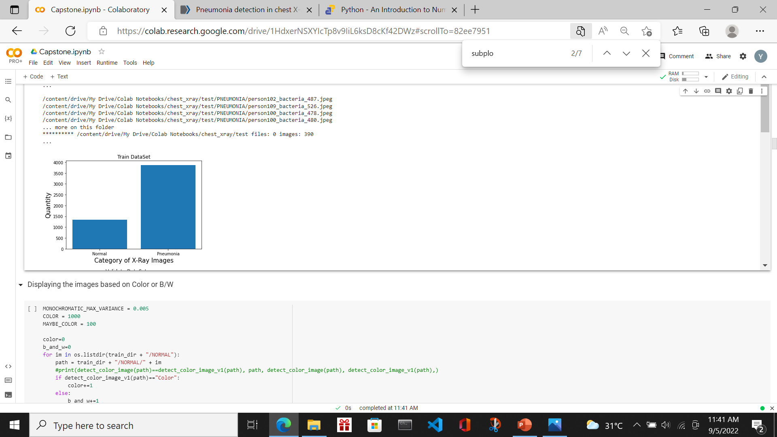
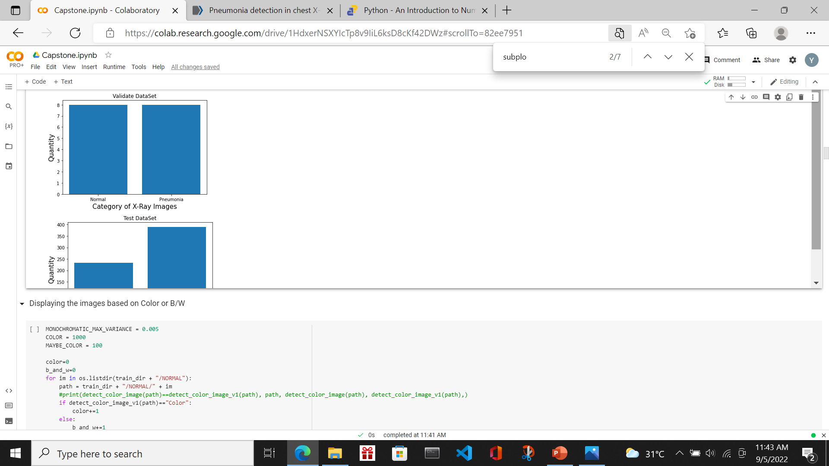
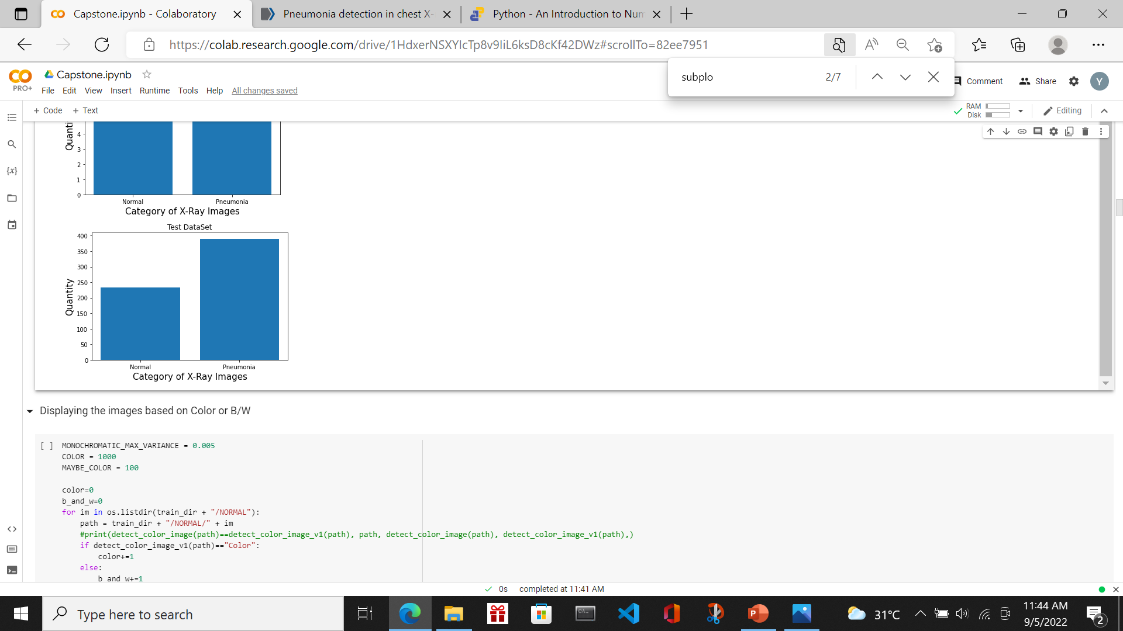
Exploratory Data Analysis
Datasets:
Normal Train: B&W 1341 pictures
Pneumonia Train: B&W 3875 pictures
Normal Val: B&W 8 pictures
Pneumonia Val: B&W 8 pictures
Normal Test: B&W 234 pictures
Pneumonia Test: B&W 390 pictures

Slide 6
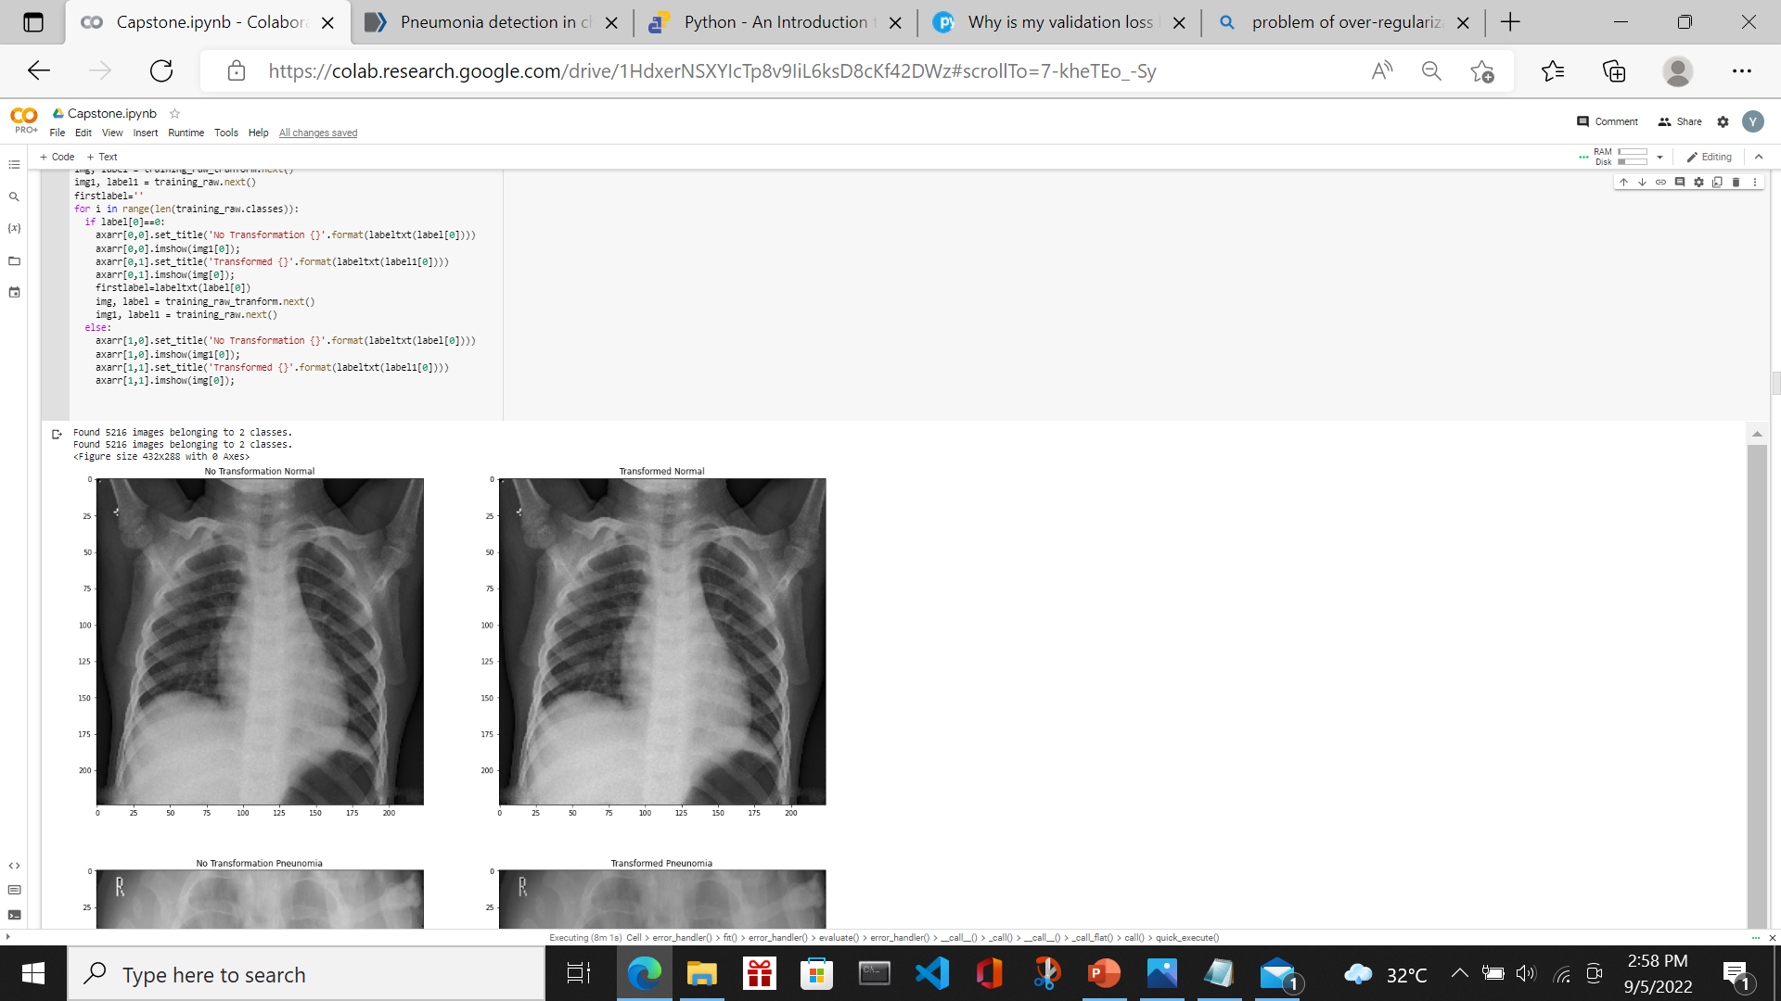
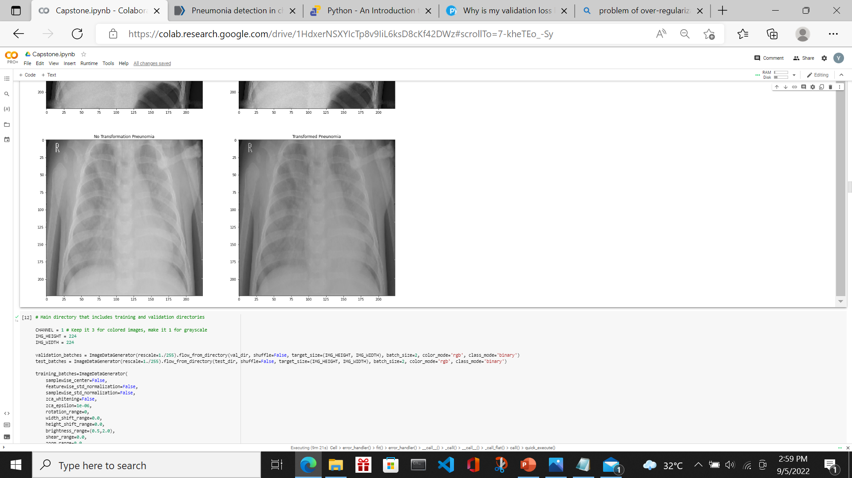
Exploratory Data Analysis
Normal Chest X-Ray (label as 0)
Pneumonia Chest X-Ray (label as 1)
Above plot confirms that for Pneumonia cases, there are white patches in the lung area as compared to Normal case. In order to make a stronger contrast between the 2 types of images, data augmentation (such as tune brightness, horizonal and vertical flip) is recommended

Slide 7
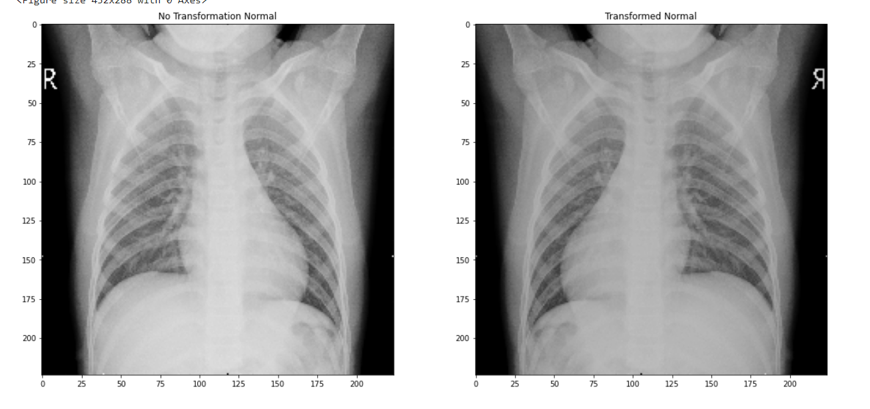
Feature Engineering
Data augmentation will increase the diversity of the training set. This is done by
image rotation,
tune the brightness of the images,
flip the images vertically and horizontally.
Below transformed image for a Normal case is darker and horizonal flipped.

Slide 8
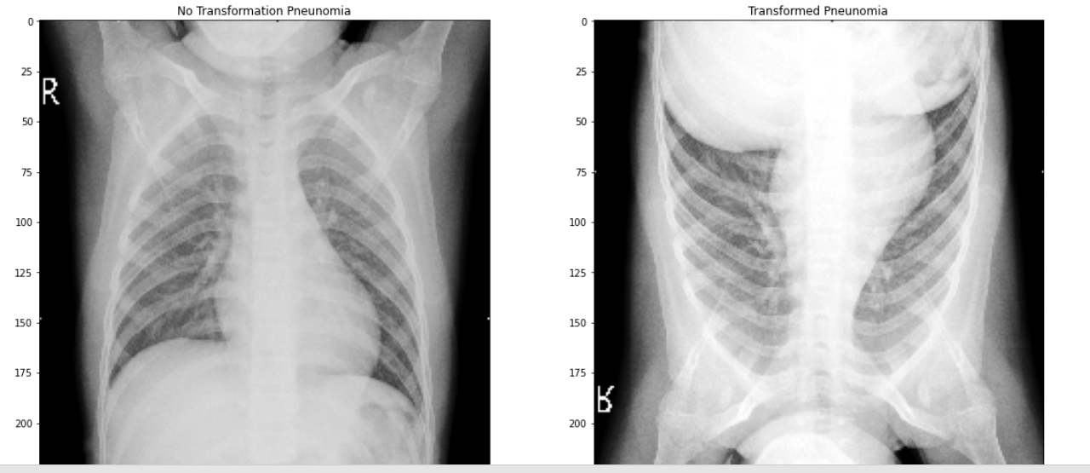
Feature Engineering
This is a Pneumonia case. Transformed image brighter, horizontal/vertical flip.

Slide 9
Evaluation Metrics
In the selection of the appropriate model, the metrics used will be the accuracy and recall. Objective is to increase accuracy yet with low level of false negative
Accuracy = (tp+tn)/(tp+fp+tn+fn)
Recall= tp/(tp+fn)
On top of it, it needs to be supported with a plot of accuracy and loss of training and validation dataset
tp :True Positive
fn : False Negative
tn : True Negative
fn : False Negative

Slide 10
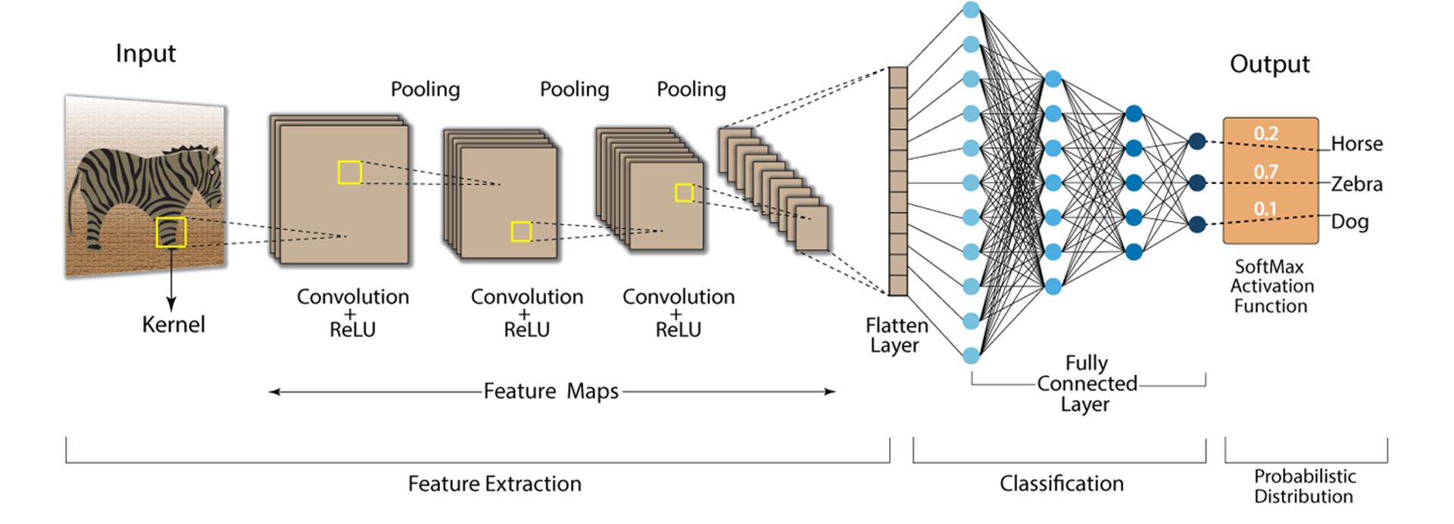
CNN Model
Pooling layers are used to compress the output of Convolution layers
Convolution layers are used to detect features in images

Slide 11
Modelling Base Model- CNN architecture
CNN layer
Classifier
Conv2D 1-1
Dense Relu
Dense Softmax
Input
Output
This is architecture for Base Model

Slide 12
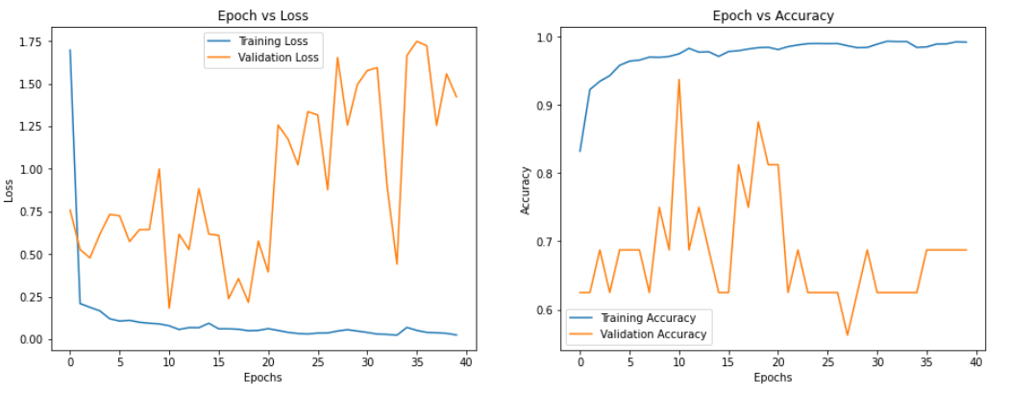
Modelling
Model | HyperParameters | Epoch | Accuracy | Misclass | Precision | Recall | Specificity
Base CNN- 3 layers | learning_rate=0.000001, beta_1=0.9, beta_2=0.999, epsilon=1e-08, decay=0.000005 | 40 | 0.7163 | 0.2837 | 0.6969 | 0.9667 | 0.2991
The graphs seemed to suggest that overfitting seemed to occur since Training Accuracy/Loss improves while Validation Accuracy/Loss got worst as epoch increases

Slide 13
Modelling Model 1- CNN architecture
CNN layer
Classifier
Conv2D 1-1
Maxpool 1-2
Dropout 1-3
Dense Relu
Dense Softmax
Input
Output
This is architecture for Model 1

Slide 14
Modelling Model 2- CNN architecture
CNN Layers
Classifier
Conv2D 1-1
MaxPooling
Batch 2-1
Conv2D 2-2
Conv2D 2-3
MaxPooling
Dropout
Batch
Dense Relu
Dropout
Batch
Dense Relu
Dropout
Batch
Dense Relu
Dropout
Batch
Dense Softmax
Input
Output
This is model 2 architecture

Slide 15
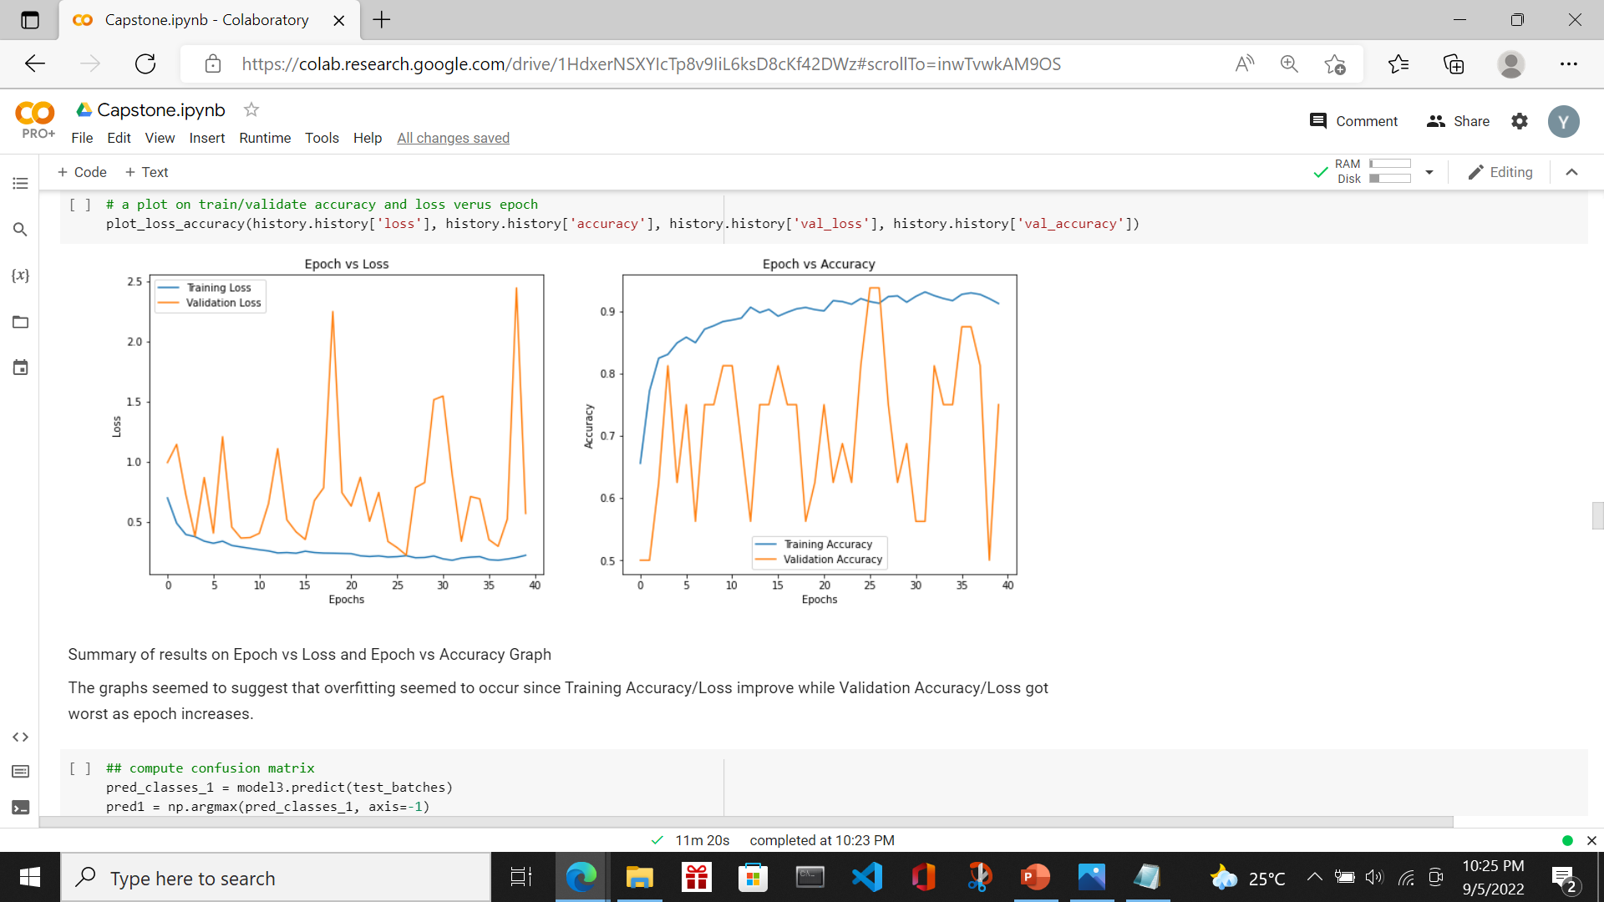
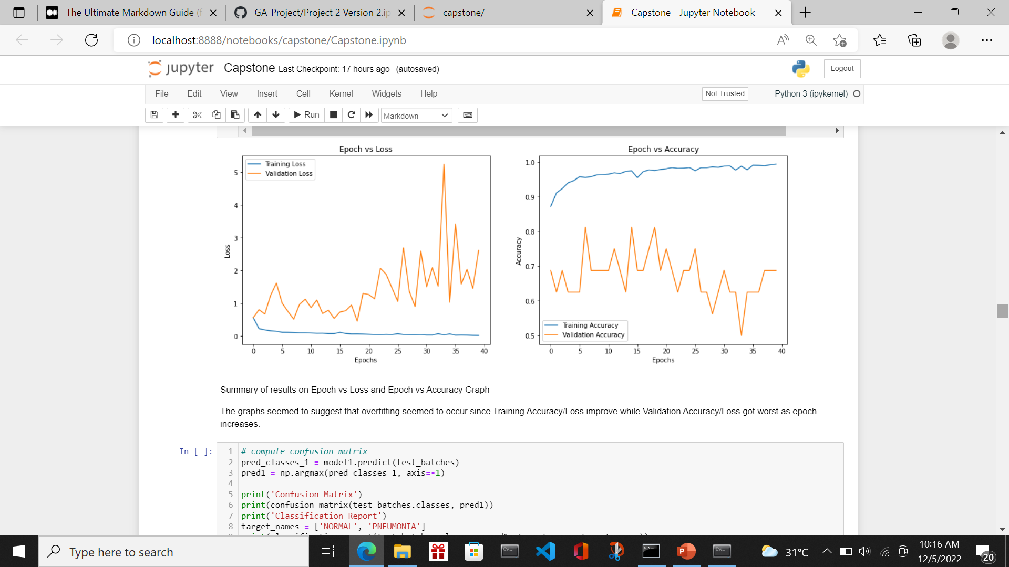
Modelling
Model | HyperParameters | Epoch | Accuracy | Misclass | Precision | Recall | Specificity
Model 1 - CNN- 7 layers | learning_rate=0.000001, beta_1=0.9, beta_2=0.999, epsilon=1e-08, decay=0.000005 | 40 | 0.7115 | 0.2885 | 0.6959 | 0.9564 | 0.3034
Model 2 - CNN- 19 layers | learning_rate=0.000001, beta_1=0.9, beta_2=0.999, epsilon=1e-08, decay=0.000005 | 40 | 0.7308 | 0.2692 | 0.6996 | 0.9974 | 0.2863
Model 1- The plot is not satisfactory. So essential to add in more layers in Feature Extraction
Model 2- The plot on accuracy and loss of train and validation improves. However, the validation data accuracy and loss is fluctuating.
CNN model built from scratch may not be a desirable model as large amount of data is necessary to acquire the desired accuracy. Next is to try out Transfer Learning.

Slide 16
Modelling VGG-19 architecture
Dropout will try to remove the noise data and thus prevent the model from over-fitting.
Pre-trained network- Frozen weights
Classifier
Conv2D 1-1
Conv2D 1-2
MaxPooling
Conv2D 2-1
Conv2D 2-2
MaxPooling
Conv2D 3-1
Conv2D 3-2
Conv2D 3-3
Conv2D 3-4
MaxPooling
Conv2D 3-1
Conv2D 3-2
Conv2D 3-3
Conv2D 3-4
MaxPooling
Conv2D 4-1
Conv2D 4-2
Conv2D 4-3
Conv2D 4-4
MaxPooling
Dense Relu
Dropout
Dense Relu
Dropout
Dense Softmax
Input
Output
Transfer learning is a work-around to surmount this obstacle. A pre-trained model on a large dataset is re-used and the network weights determined are applied
For model 3 and model 4, I will be using the above pre-trained VGG-19 architecture with no change in classifier layers

Slide 17
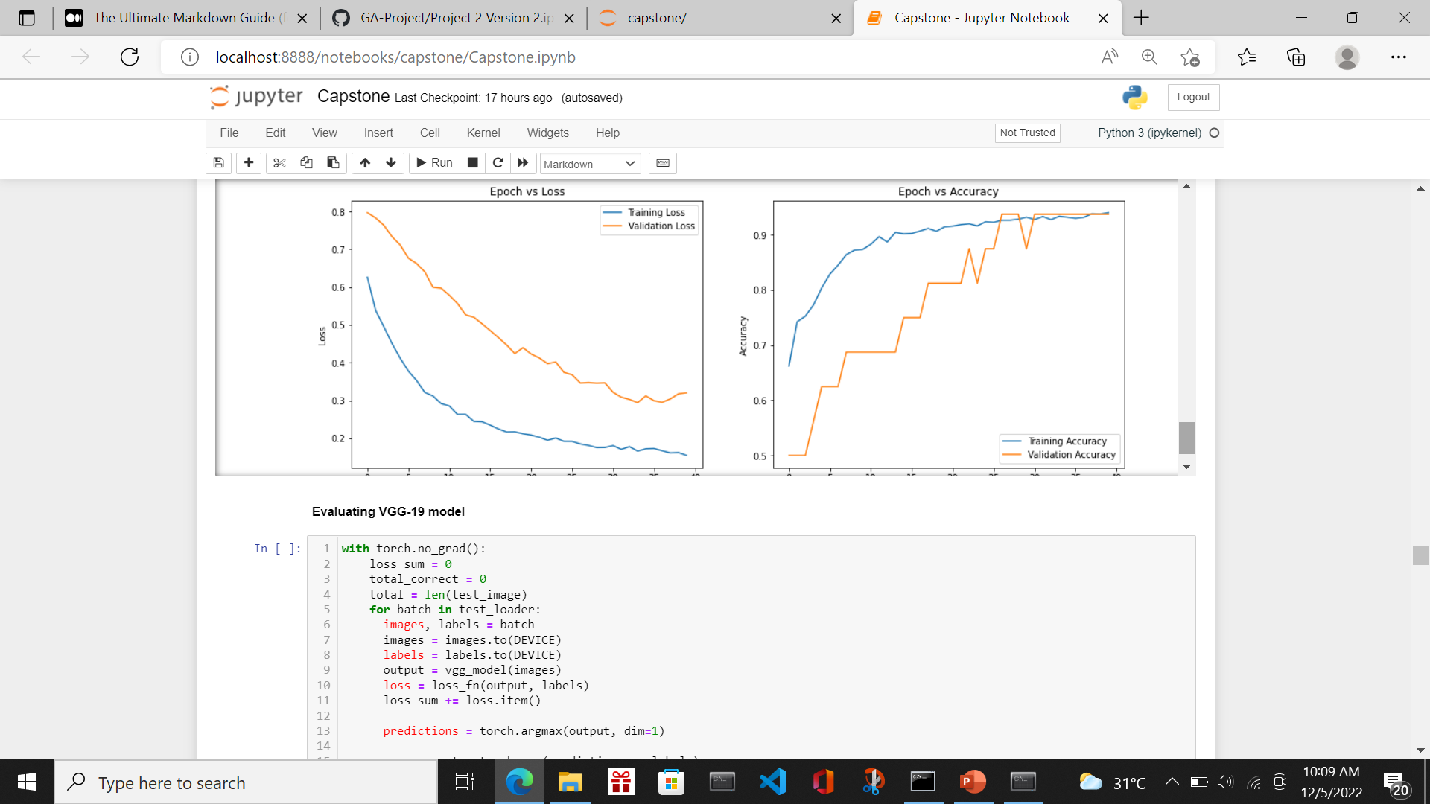
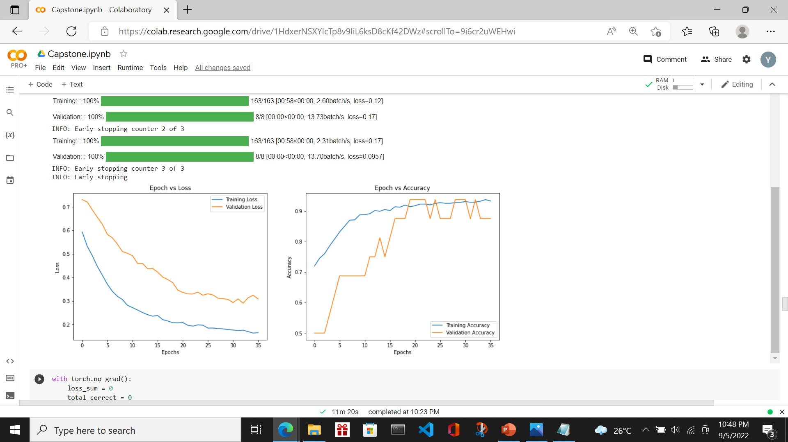
Modelling
Model | HyperParameters | Epoch | Accuracy | Misclass | Precision | Recall | Specificity
Model 3 - VGG 19 | decay=0.000005, amsgrad: False, betas: (0.9, 0.999) epsilon: 1e-08, learning rate: 1e-06,maximize: False weight_decay: 0 | 40 | 0.851 | 0.149 | 0.8293 | 0.959 | 0.6709
Model 4 - VGG 19 | decay=0.000005, amsgrad: False, betas: (0.9, 0.999) epsilon: 1e-08, learning rate: 1e-06, maximize: False weight_decay: 0, Earlystopping | 35 | 0.8542 | 0.1458 | 0.8286 | 0.9667 | 0.6667
The accuracy and recall both improved using Transfer Learning.
The plot on loss and accuracy of train and validation dataset also improves.

Slide 18
Modelling Model 5- VGG-19 architecture
Pre-trained network- Frozen weights
Classifier
Conv2D 1-1
Conv2D 1-2
MaxPooling
Conv2D 2-1
Conv2D 2-2
MaxPooling
Conv2D 3-1
Conv2D 3-2
Conv2D 3-3
Conv2D 3-4
MaxPooling
Conv2D 3-1
Conv2D 3-2
Conv2D 3-3
Conv2D 3-4
MaxPooling
Conv2D 4-1
Conv2D 4-2
Conv2D 4-3
Conv2D 4-4
MaxPooling
Dense Relu
Dense Relu
Dense Softmax
Input
Output
In model 5, I will remove some layers in the Classifier layers.

Slide 19
Modelling Model 6- VGG-19 architecture
Pre-trained network- Frozen weights
Classifier
Conv2D 1-1
Conv2D 1-2
MaxPooling
Conv2D 2-1
Conv2D 2-2
MaxPooling
Conv2D 3-1
Conv2D 3-2
Conv2D 3-3
Conv2D 3-4
MaxPooling
Conv2D 3-1
Conv2D 3-2
Conv2D 3-3
Conv2D 3-4
MaxPooling
Conv2D 4-1
Conv2D 4-2
Conv2D 4-3
Conv2D 4-4
MaxPooling
Dense Relu 1-1
Dropout 1-2
Batch 1-3
Dense Relu 2-1
Dropout 2-2
Batch 2-3
Dense Relu 3-1
Dropout 3-2
Batch 3-3
Dense Softmax
Output
Input
In model 6, I will add in more layers to the Classifier layers.
Batch Nomralization- It is a technique to train deep neural networks to standardise the inputs to a layer for every mini-batch to stabilise the learning process and reduce the number of training epochs in deep network training

Slide 20
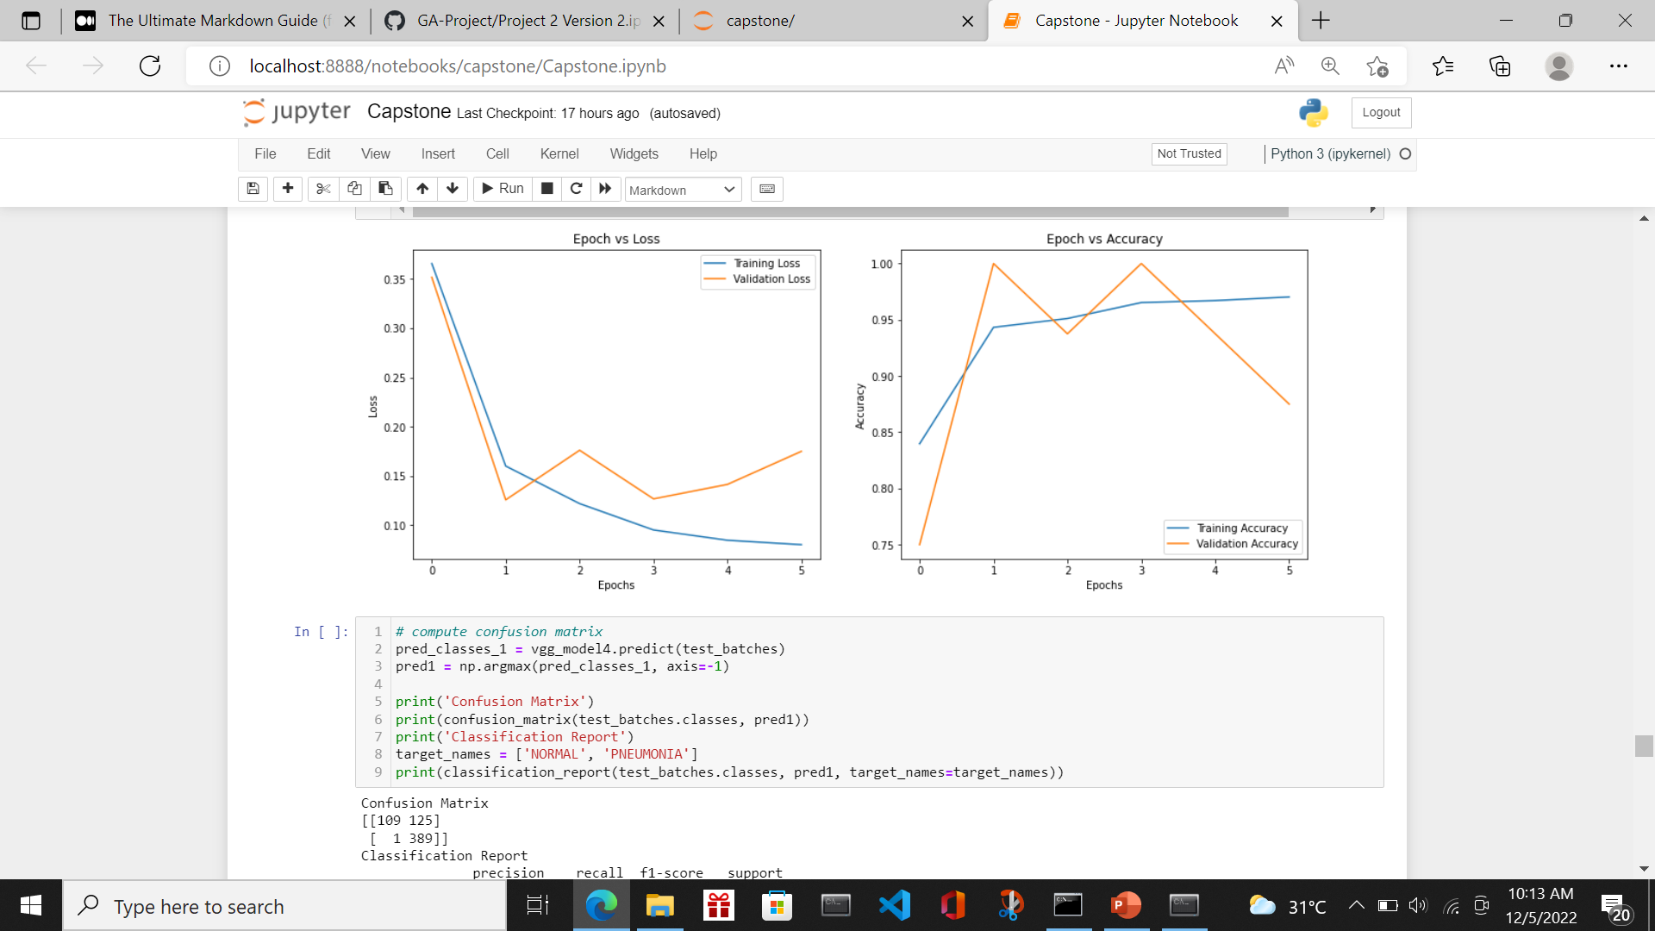
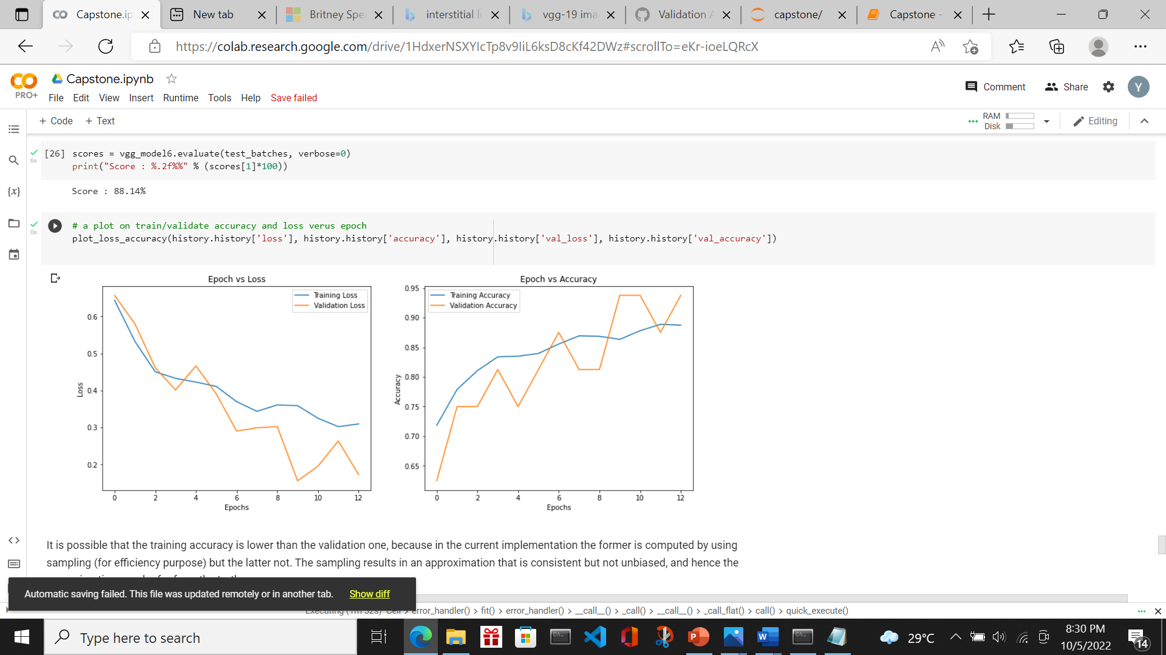
Modelling
Model | HyperParameters | Epoch | Accuracy | Misclass | Precision | Recall | Specificity
Model 5 - VGG 19 | initial_learning_rate=1e-6, decay_steps=100000, decay_rate=0.000005 earlystopping | 6 | 0.7981 | 0.2019 | 0.7568 | 0.9974 | 0.4658
Model 6 - VGG 19 | initial_learning_rate=1e-6, decay_steps=100000, decay_rate=0.000005 earlystopping | 13 | 0.8814 | 0.1186 | 0.878 | 0.941 | 0.7821
Model 5- The accuracy deteriorates. So min level of classifier layers are essential
Model 6- The accuracy and recall both improved using Transfer Learning.
The plot on loss and accuracy of train and validation dataset also improves.
Model 6 is selected eventually based on best accuracy and recall

Slide 21
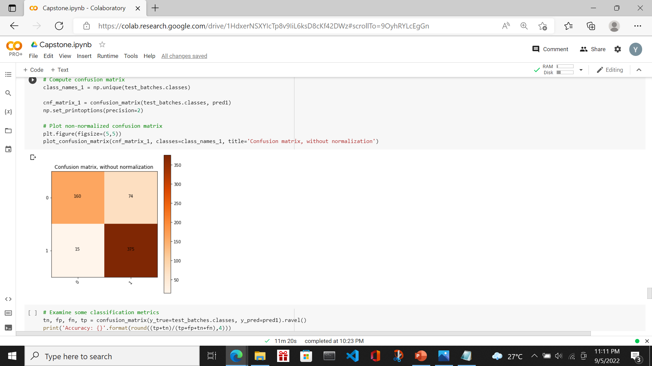
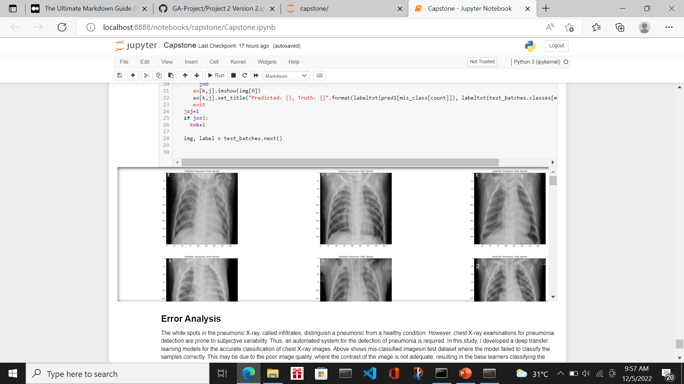
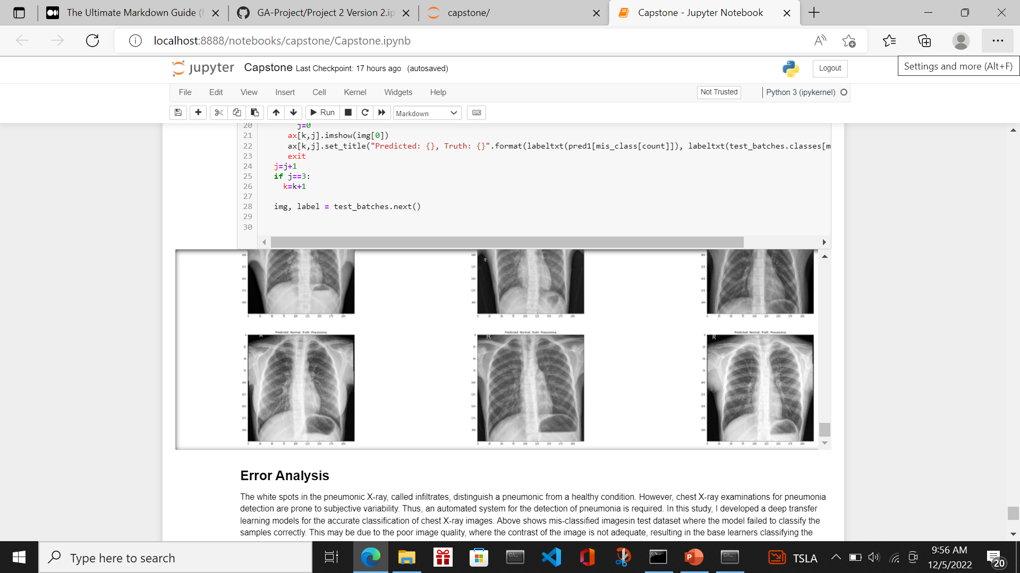
Error Analysis- Model 6
False Positive
Legend
0: Normal
1: Pneumonia
False Negative
In first image, this may be due to the poor image quality, where the contrast of the image is not adequate, resulting in the base learners classifying the sample incorrectly.
In second image, tt is plausible that such an early stage of pneumonia, where the white infiltrates have just started to appear sparingly in the lungs, was not captured by the CNN models.

Slide 22
Summary
A vast amount of labeled data is difficult to acquire because it requires that expert doctors classify each image, which is an expensive and time-consuming task.
Transfer learning is a work-around to surmount this obstacle. A model trained on a large dataset is re-used and the network weights determined in this model are applied.
The final model is taking weights from the pre-trained model. I introduced additional layers after the Flatten layer so as to customise the weights to the X-Ray images.
There is still room for improvement. In the future, we may investigate techniques such as
contrast enhancement of the images or other pre-processing steps to improve the image quality.
segmentation of the lung image before classification to enable the CNN models to achieve improved feature extraction.
ensemble of pre-trained models

Slide 23
Thank You

